Slide 1
Section 12.2
Systems of Linear Equations: Matrices
Copyright © 2012 Pearson Education, Inc. Publishing as Prentice Hall.

Slide 2

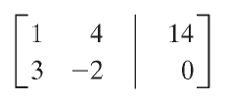
Copyright © 2012 Pearson Education, Inc. Publishing as Prentice Hall.

Slide 3
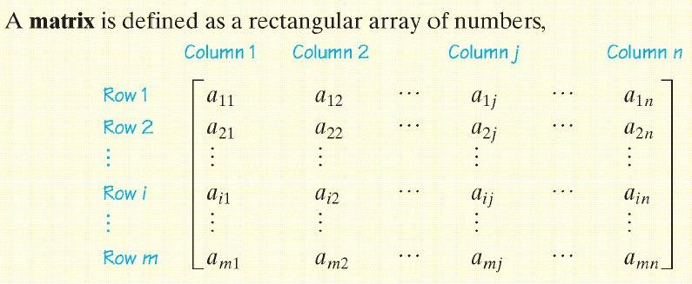
Copyright © 2012 Pearson Education, Inc. Publishing as Prentice Hall.

Slide 4
Copyright © 2012 Pearson Education, Inc. Publishing as Prentice Hall.

Slide 5

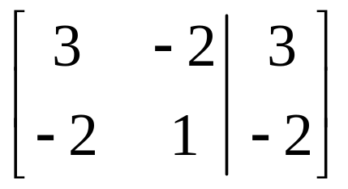
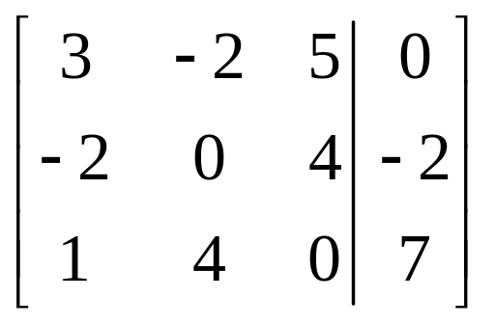
Copyright © 2012 Pearson Education, Inc. Publishing as Prentice Hall.

Slide 6
Copyright © 2012 Pearson Education, Inc. Publishing as Prentice Hall.

Slide 7

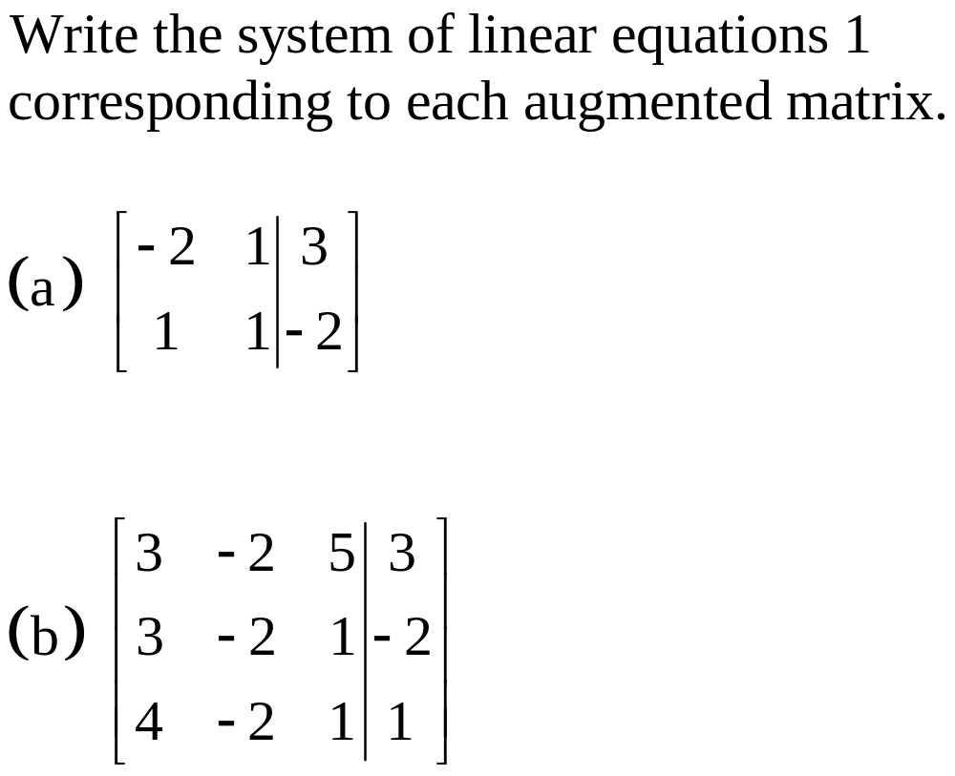
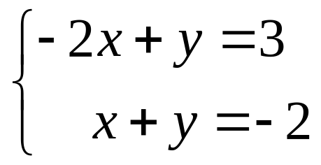
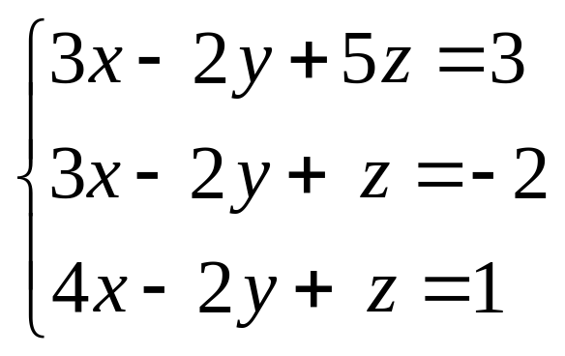
Copyright © 2012 Pearson Education, Inc. Publishing as Prentice Hall.

Slide 8

Copyright © 2012 Pearson Education, Inc. Publishing as Prentice Hall.

Slide 9
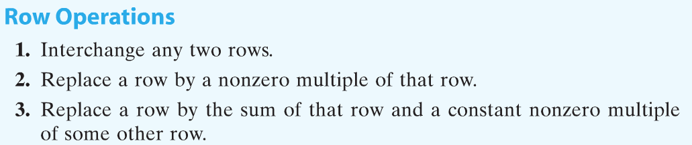
Copyright © 2012 Pearson Education, Inc. Publishing as Prentice Hall.

Slide 10
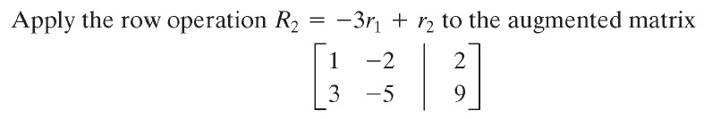
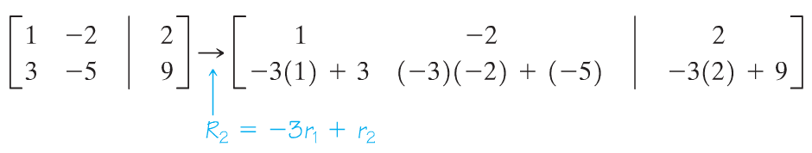
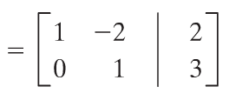
Copyright © 2012 Pearson Education, Inc. Publishing as Prentice Hall.

Slide 11
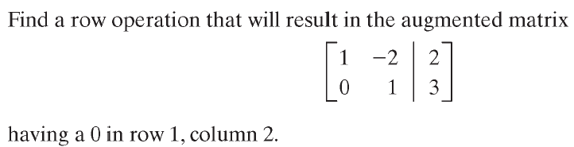
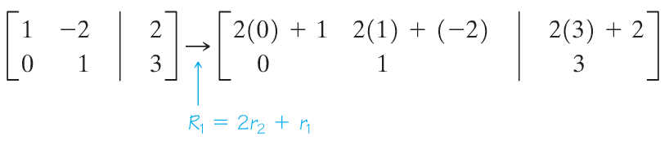
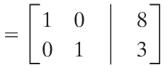
Copyright © 2012 Pearson Education, Inc. Publishing as Prentice Hall.

Slide 12
Copyright © 2012 Pearson Education, Inc. Publishing as Prentice Hall.

Slide 13

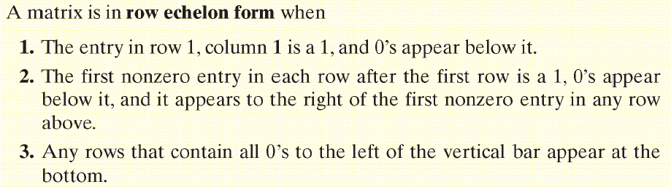
Copyright © 2012 Pearson Education, Inc. Publishing as Prentice Hall.

Slide 14
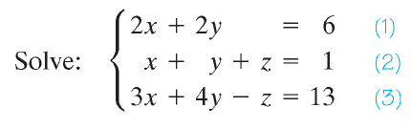
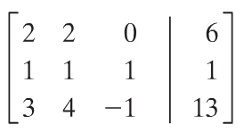

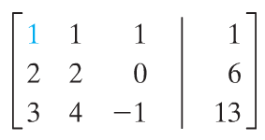
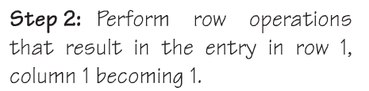
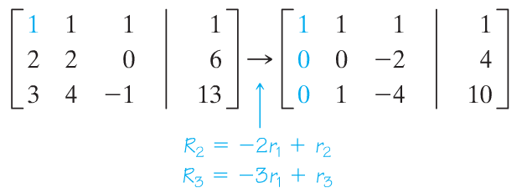
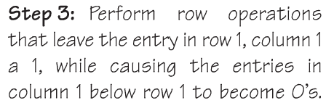
Copyright © 2012 Pearson Education, Inc. Publishing as Prentice Hall.

Slide 15
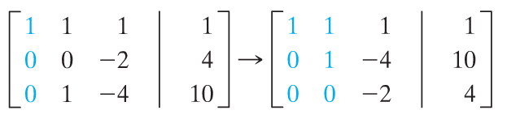
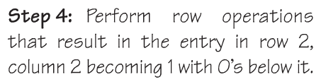
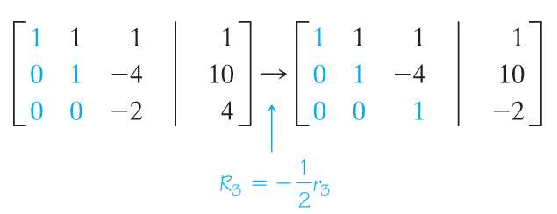

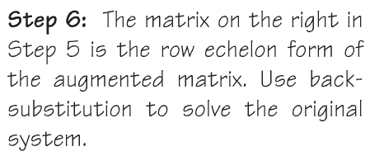





Copyright © 2012 Pearson Education, Inc. Publishing as Prentice Hall.

Slide 16
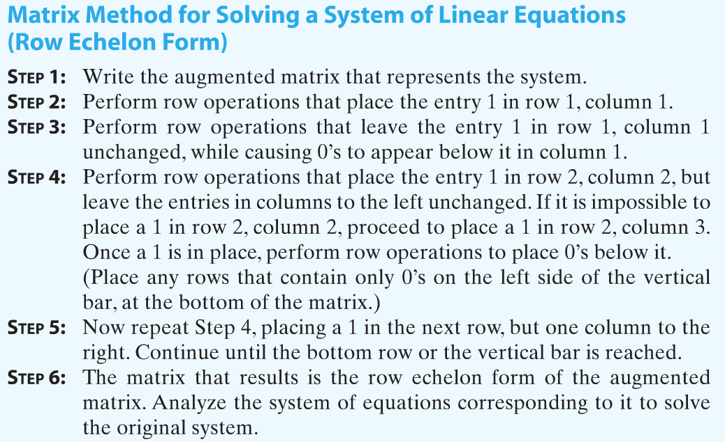
Copyright © 2012 Pearson Education, Inc. Publishing as Prentice Hall.

Slide 17
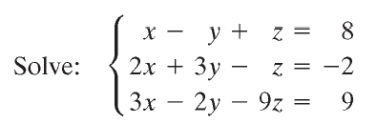
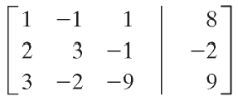
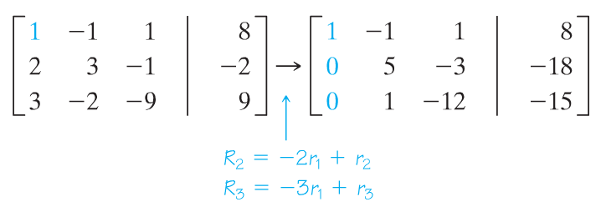
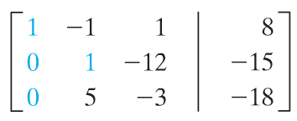
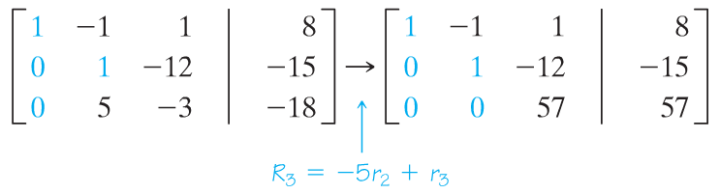
Copyright © 2012 Pearson Education, Inc. Publishing as Prentice Hall.

Slide 18
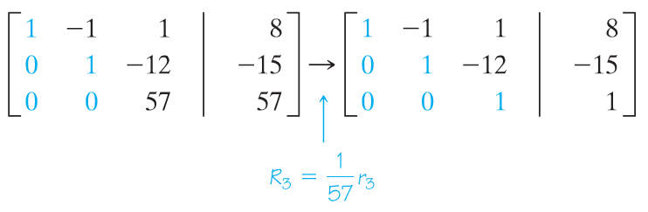
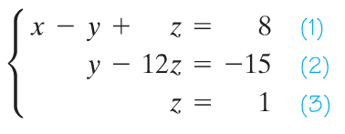
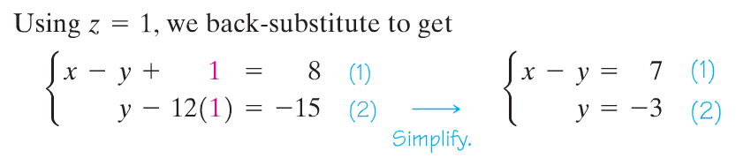
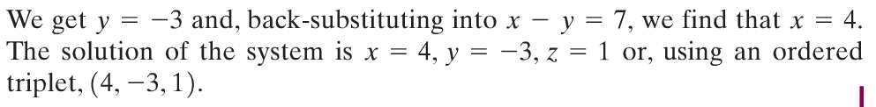
Copyright © 2012 Pearson Education, Inc. Publishing as Prentice Hall.

Slide 19
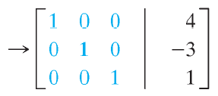
Reduced Row Echelon Form
Copyright © 2012 Pearson Education, Inc. Publishing as Prentice Hall.

Slide 20
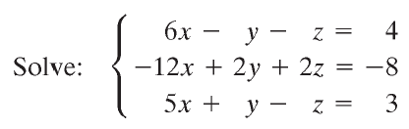
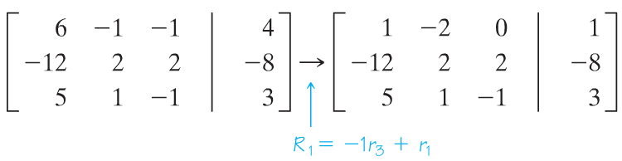
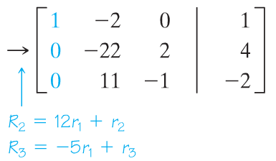
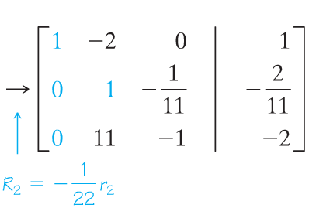
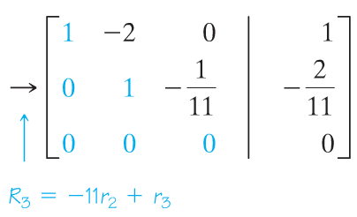
Copyright © 2012 Pearson Education, Inc. Publishing as Prentice Hall.

Slide 21
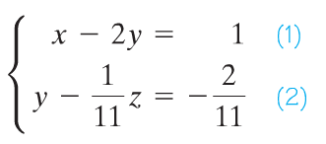



Copyright © 2012 Pearson Education, Inc. Publishing as Prentice Hall.

Slide 22
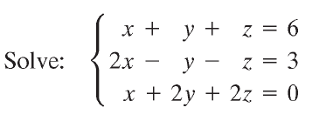
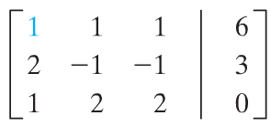
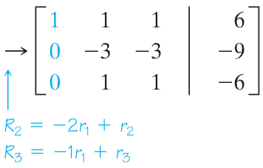
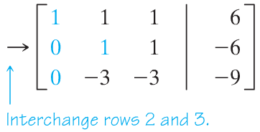
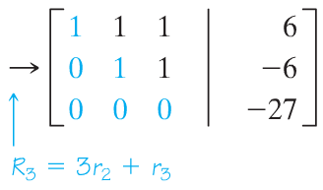
The system is inconsistent.
Copyright © 2012 Pearson Education, Inc. Publishing as Prentice Hall.

Slide 23
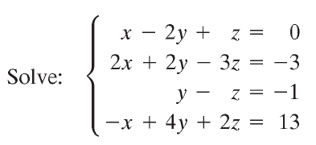
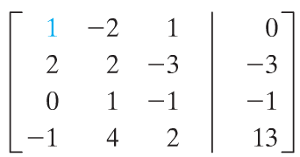
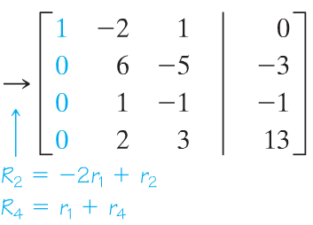



Copyright © 2012 Pearson Education, Inc. Publishing as Prentice Hall.

Slide 24


Copyright © 2012 Pearson Education, Inc. Publishing as Prentice Hall.

Slide 25





Copyright © 2012 Pearson Education, Inc. Publishing as Prentice Hall.

Slide 26







Copyright © 2012 Pearson Education, Inc. Publishing as Prentice Hall.

